Slide 1

Smart Traffic Fine Generation System
Presented by:- Guides:-
Dhruvkumar Patel (15CP049) [1] Dr. N.M Patel
Ketan Bhalerao (15CP050) [2] Prof. P.B Swadas
Monil Shah (15CP051)

Slide 2
Introduction
These days traffic is increasing at an alarming rate. This leads to uncontrollable traffic at crossroads. Moreover, certain rules have been incorporated by RTO which are necessary for maintaining public discipline.
However, a very practical fact proves that people these days hardly obey the incorporated rules which may result in severe accidents as well as society indiscipline.
This project aims to tackle these problems via a fully automated system which will track the moving vehicles on road and if a particular vehicle breaks a rule of surpassing crossroads while red light is on, the same vehicle’ s identity will be extracted through machine learning algorithms.
Later, after the identity of vehicle has been determined, an automated fine deduction will take place from vehicle owner’s account of which the user will be Mailed or texted.

Slide 3
Project Outline
Record the video of moving vehicles
Separate the frames of received video
Remove the duplicate frames
Apply object detection algorithm for getting vehicle’s number plate
Apply CNN on number plate
Match the vehicle’s number in database
Send an email to owner of vehicle

Slide 4
Project Modules
Number Plate Detection
Number Recognition
Fine Generation through Email notification

Slide 5
Technologies to be utilized
Python 2.7
CNN Modules: Tensorflow and Keras
YOLO (for Object Detection)
MySQL Database
Image Processing libraries: OpenCV, PIL
Transfer Learning Model: Inception V3
Google cloud platform
Python GUI library tkinter

Slide 6
Work done till now...
Number Plate Detection Using the logic of edge detection.
CNN trained using MNIST dataset and various other machin e learning platforms
Database normalized schema made ready in MySQL.
Prepared a GUI for displaying results and collecting dataset.
Prepared a dataset of number plates and their respective co-ordinates
Tried training YOLO for number plate detection over various cloud services as well as GPU.
Utilized ResNet50 model to detect car from the image.

Slide 7
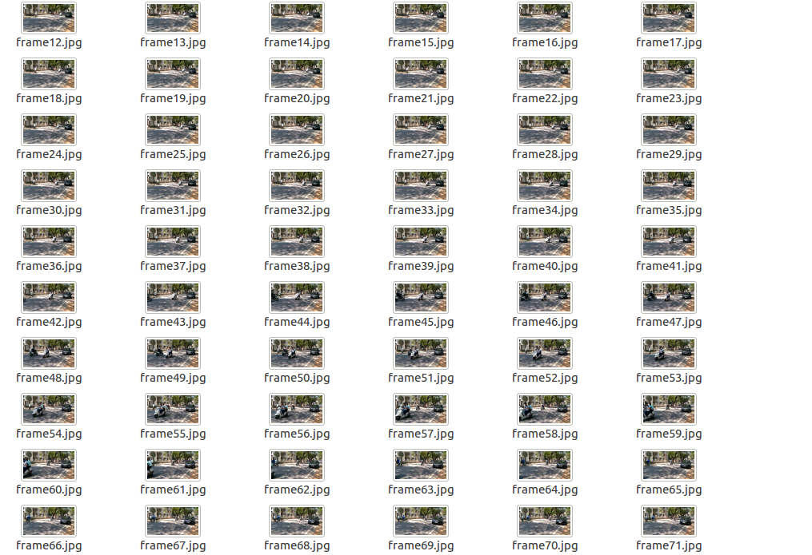
Video Processing

Slide 8
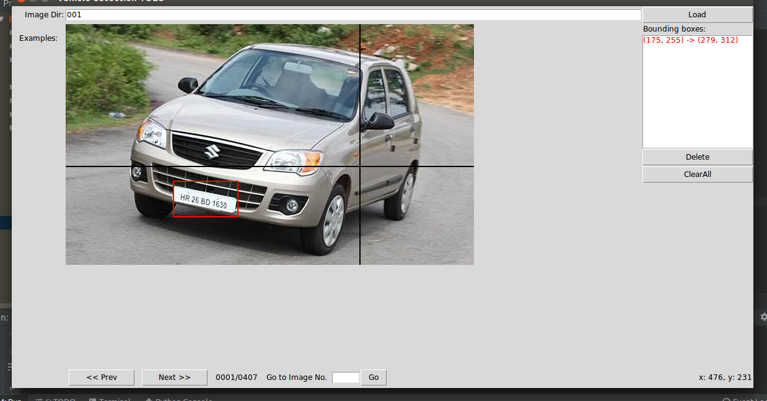
PREPARING GUI FOR CREATING DATASET OF YOLO OBJECT BOUNDING BOX FOR GENERATING VEHICLE’S NUMBER PLATE

Slide 9
Utilization of ResNet50 model
What if a captured frame has more than a single vehicle?
One possible answer: Separate out every vehicle from captured frame and feed every extracted image in iterative fashion to YOLO for number plate detection.

Slide 10
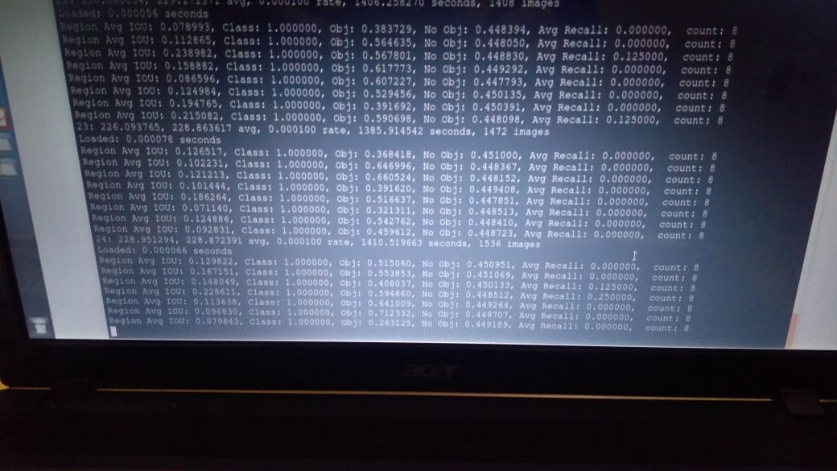
YOLO Training Iterations

Slide 11
Number plate detection

Slide 12
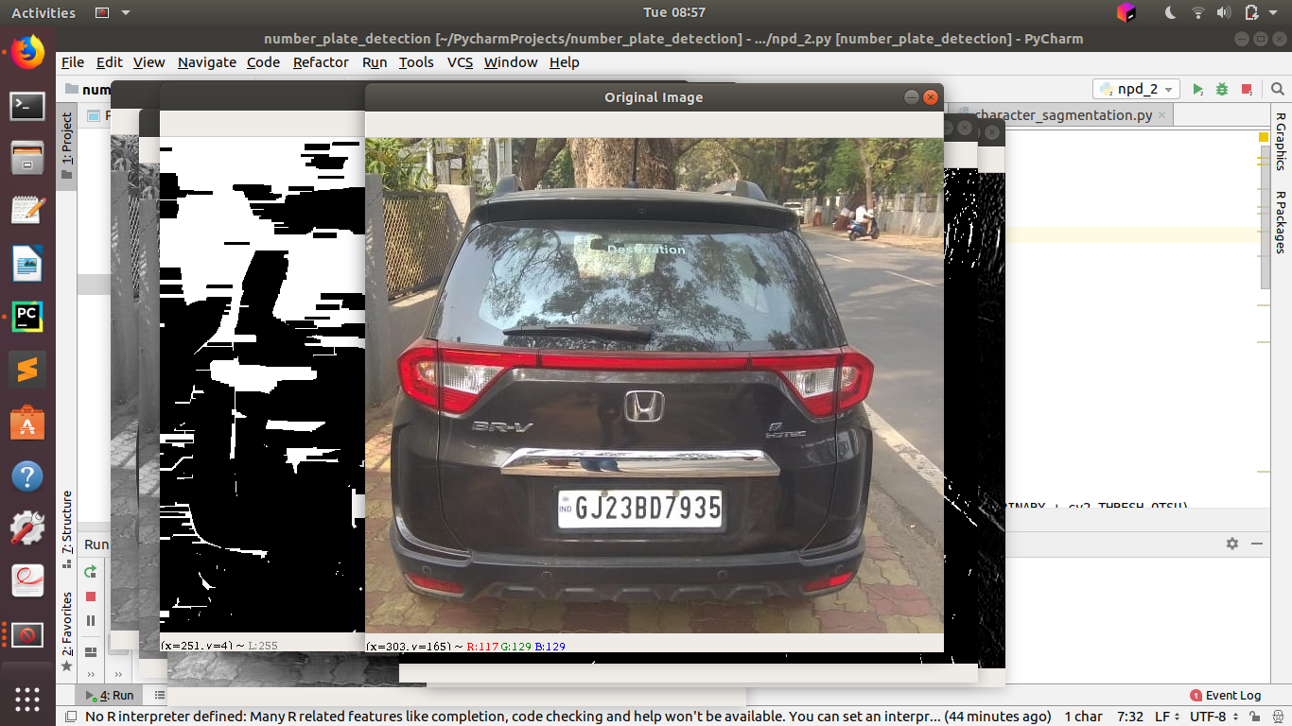
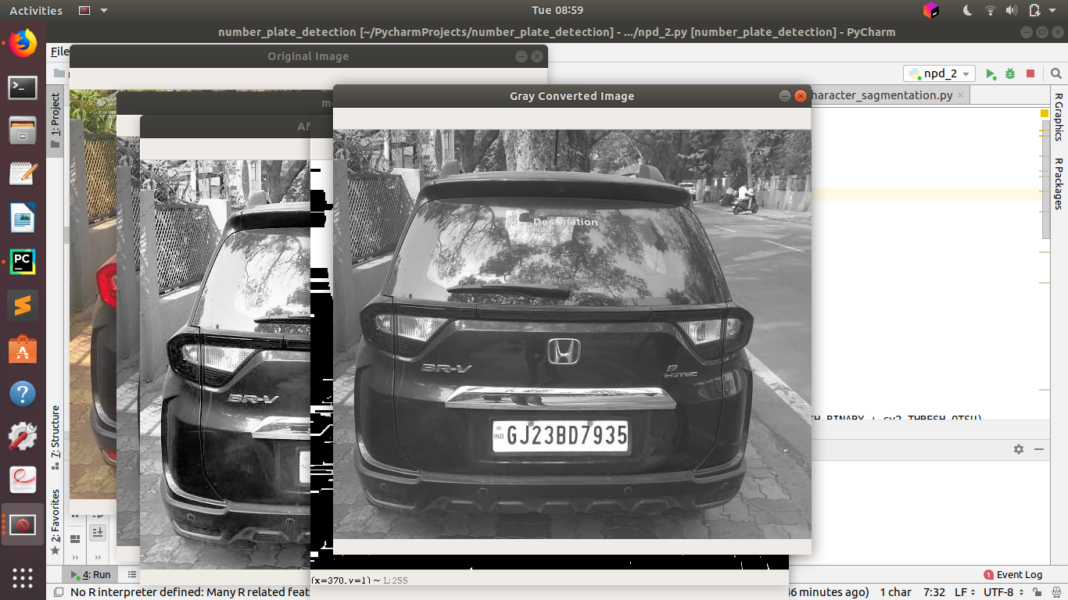
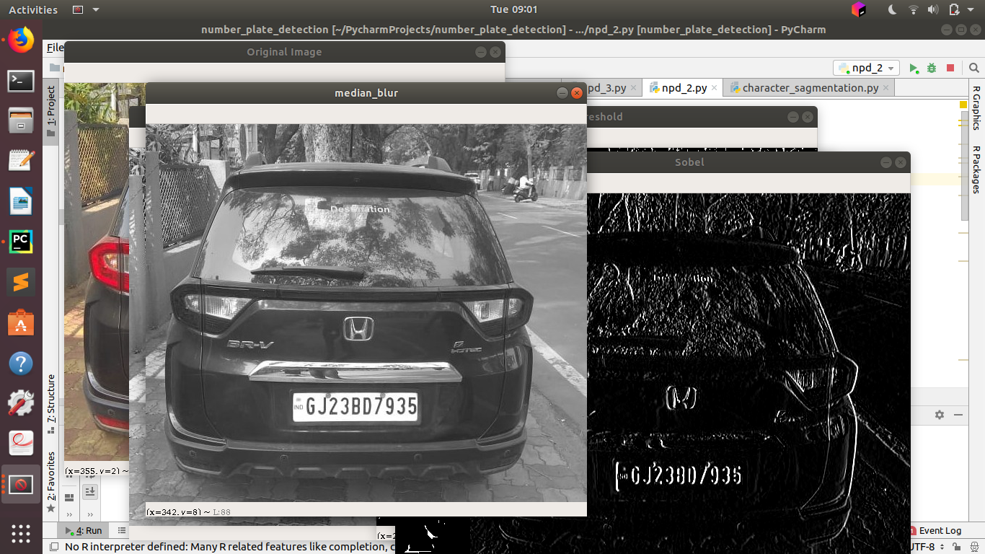
Original Image
Gray Scale conversion
Noise removal using median blur

Slide 13
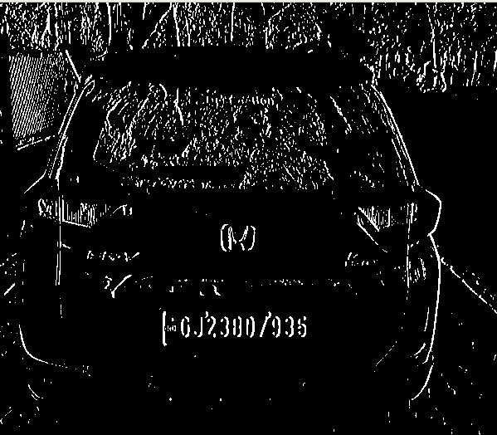
Image Binarization

Slide 14
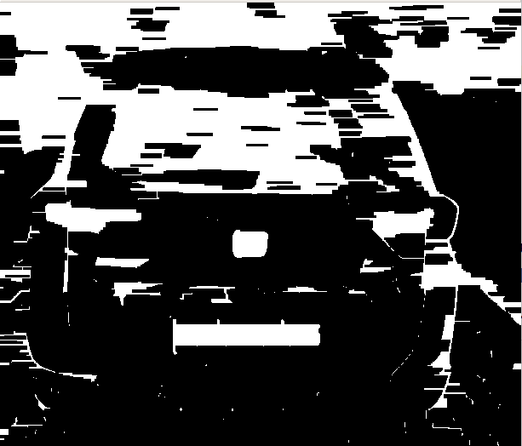
Morphological Transformation

Slide 15
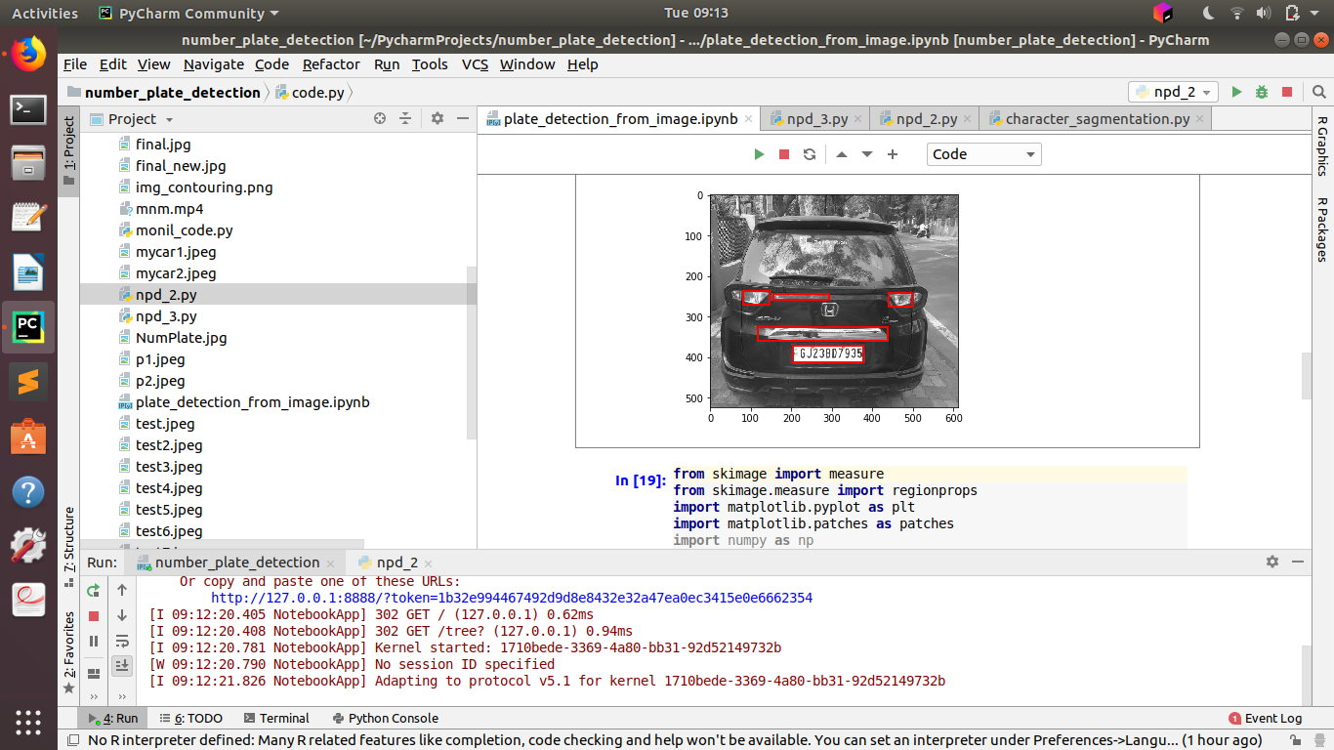
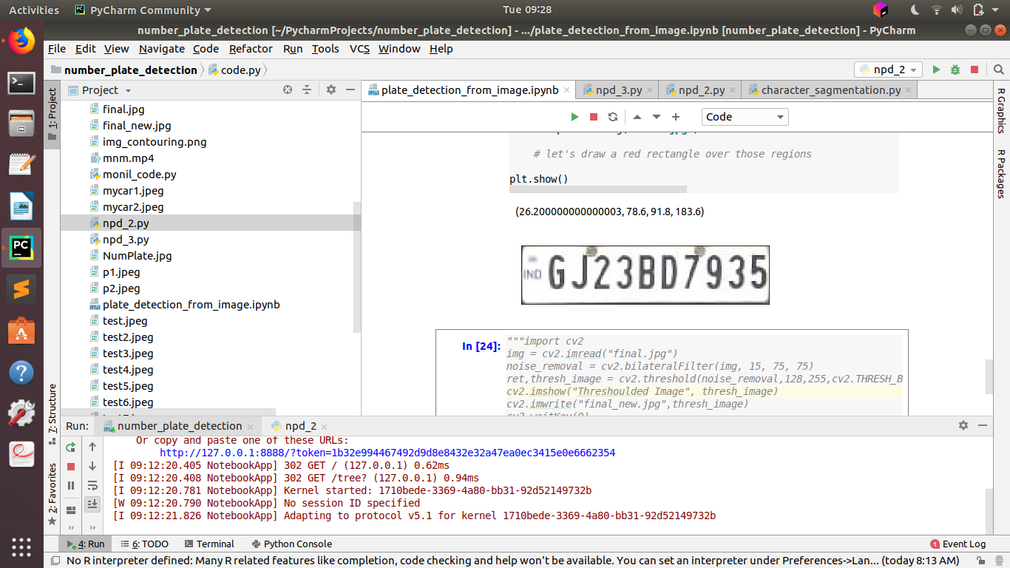
Image Contouring
Extracted Number Plate

Slide 16
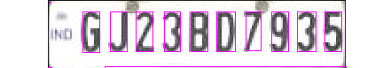
Character Segmentation using image contouring

Slide 17
Extracting number from the obtained number plate
Approach used: CNN
Achieved Accuracy till 1st midsem was 91.00% (trained from Scratch over 15,00,000 dataset images for 36 classes- 0 to 9 and A to Z)

Slide 18
A step towards Transfer learning
Following models were chosen to perform fine tuning over a subset of our original dataset:
1] Inception V3
2] MobileNet
3] VGG16

Slide 19
Accuracies over Inception V3
Accuracy
Image Size

Slide 20
Accuracies over MobileNet
Accuracy
Image size

Slide 21
Accuracies over VGG16
Accuracy
Image size

Slide 22
Overall Results
Avg. Accuracies
Approaches

Slide 23
Improving the model trained from scratch
Initial accuracy: 91%
Increased Neural Network’s body
Used LeakyReLU instead of ReLU
Decreased learning rate to 1e-4
Resulting Accuracy: 97.6%

Slide 24
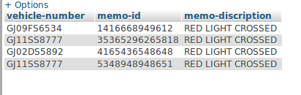
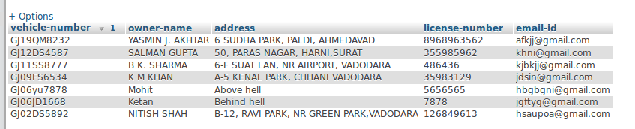
MEMO TABLE
VEHICLE OWNER DETAILS

Slide 25
Our current targets
Train YOLO over our self prepared dataset.
Prepare automatic Notification generation code for informing the vehicle’s owner.
Prepare a GUI for easy interaction with system.
Integration of all module

Slide 26
Project Applications
It can used be to maintain discipline among public, there by decreasing the risk of traffic accidents.
Man labor will be reduced thus leading to reliable system.
Digitization in traffic controlling system will prove as a push to digital India’s mission.
Transparency in fine collection will be improved.

Slide 27
Thank You!

